Slide 1
Abdominal Damage Control
Babak Sarani, MD, FACS
Assistant Professor of Surgery
Division of Traumatology and Surgical Critical care
University of Pennsylvania

Slide 2
Objectives
Definition of Damage Control
Indications for and technique of abdominal damage control
Complications associated with abdominal damage control and their management
Outcomes with use of Damage Control for abdominal trauma

Slide 3
Priorities in Treatment
Damage control / Abbreviated laparotomy
  Obtain hemorrhage control
  Obtain contamination control
  Obtain temporary coverage
NOT Bail-out surgery
Notes:
damage control. This term, as used by the United States Navy, refers to “the capacity of a ship to absorb damage and maintain mission integrity” (2), while the implication in trauma surgery is the sum total of the maneuvers necessary to ensure patient survival above all else. (3)
The traditional approach of exploratory laparotomy for definitive repair of all injuries works well in patients who have either a limited number of injuries or visceral injuries without a major vascular injury. The difficulty lies in the maintenance of physiologic stability during the struggle for surgical control of hemorrhage. Damage control is defined as the initial control of hemorrhage and contamination followed by intraperitoneal packing and rapid closure which allows for resuscitation to normal physiology in the intensive care unit and subsequent definitive re-exploration.(4)
Abbreviated laparotomy is that part of damage control involving only abdominal surgery. Bail-out surgery is used after the patient has become too unstable to continue and the operative procedure has to be aborted in an unplanned fashion with the patient in extremis.
Damage control has three separate and distinct aspects. First, control of hemorrhage and contamination, definitive repairs are deferred, and the laparotomy is terminated. Temporary closure of the abdomen then patient taken to the intensive care unit rewarming, correction of coagulopathy, and maximization of hemodynamic . When normal physiology has been restored, re-exploration complete the definitive surgical management.(4)(5)

Slide 4
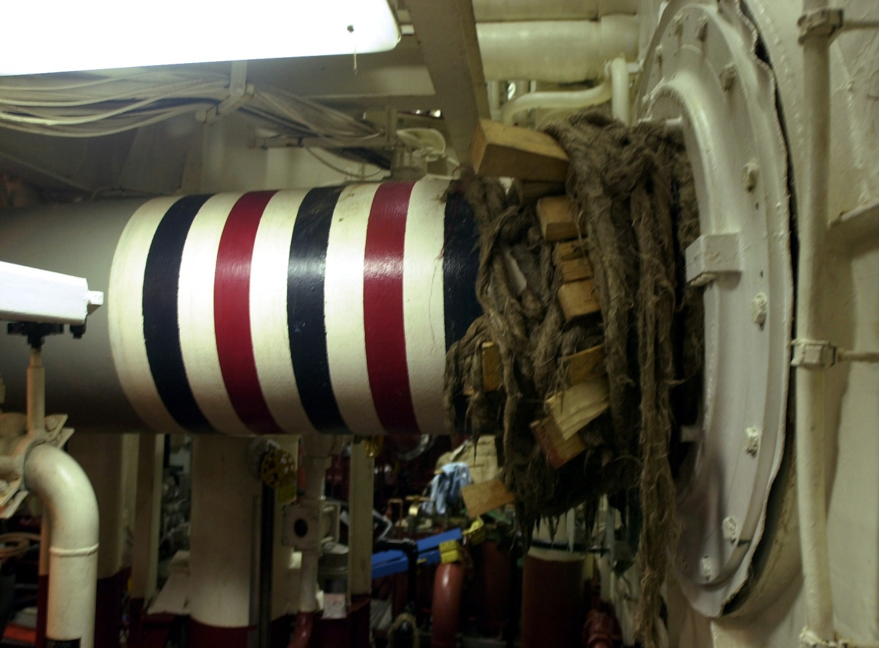
Practical application of Damage Control
Wrapping and plugging of damaged
propeller shaft
Notes:
Damage control was first described by Stone in Emory in 1983. Stopped operation when coagulopathy was noted. Used packing and left bowel in discontinuity. Term coined by Schwab.

Slide 5
Damage Control Sequence
DC0 “Ground zero” - Recognition
DC I – OR (warmed)
Rapid transport (EMS)
Decision ----> OR
Resuscitation (TB)
  O2, Blood, Prevent heat loss Massive transfusion protocol
Control hemorrhage
Control contamination
Intraabdominal packing
TAC
Minutes
< 2 hrs
DC II - ICU
Rewarming
Correct coagulopathy
Maximize hemodynamics
Ventilatory support
Re-exam
DC III - OR
~24-36 hrs
Pack removal
Definitive repairs
Closure ?
DC IV - OR
Definitive Closure
48hrs –1yr
Johnson, Gracias, Schwab, et al. JTrauma 2001.

Slide 6
Conventional
Event
Time
Pre-hospital
ED
OR
ICU
Definitive surgery
• repair
• reconstruct
ALS

Slide 7
Damage Control
Event
Time
Prehospital
ED
OR
ICU
OR
ICU
Control bleeding
• bleeding
• contamination
Pack
Planned reoperation
• reconstruction
• repair
ALS

Slide 8
Lethal Triad
Acidosis
Hypothermia (<35 C)
Coagulopathy
Notes:
Mortality starts to rise when the temp drops below 34 and approaches 100% when the temp drops below 32.
Acidosis can be defined as an elevated lactate > 48 hours after arrival
20% of trauma pts are hypothermic on arrival, 46% are hypothermic after the OR.

Slide 9
Damage Control
Who?
Shock
Massive transfusion (> 10 Units PRBC)
Clinical coagulopathy
Hypothermia (< 95 F or 35 C)
Multiple life threatening injury
Inaccessible major injury (retro-hepatic IVC, pelvis) and demand for non-operative control
Need for time consuming procedure(s)
Indeterminate serious injury (pancreatic duct)
Surgeon Judgment

Slide 10
“Getting Control”
Surgery (Damage control Part I)
The more injured the patient with more severe pathophysiology paradoxically requires less to be done at this initial stage.
MB Shapiro, J Trauma, November 2000

Slide 11
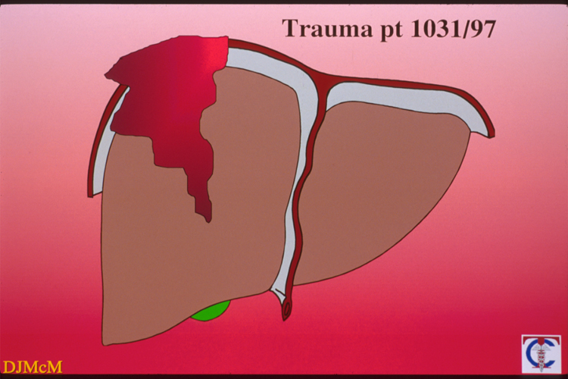

Slide 12
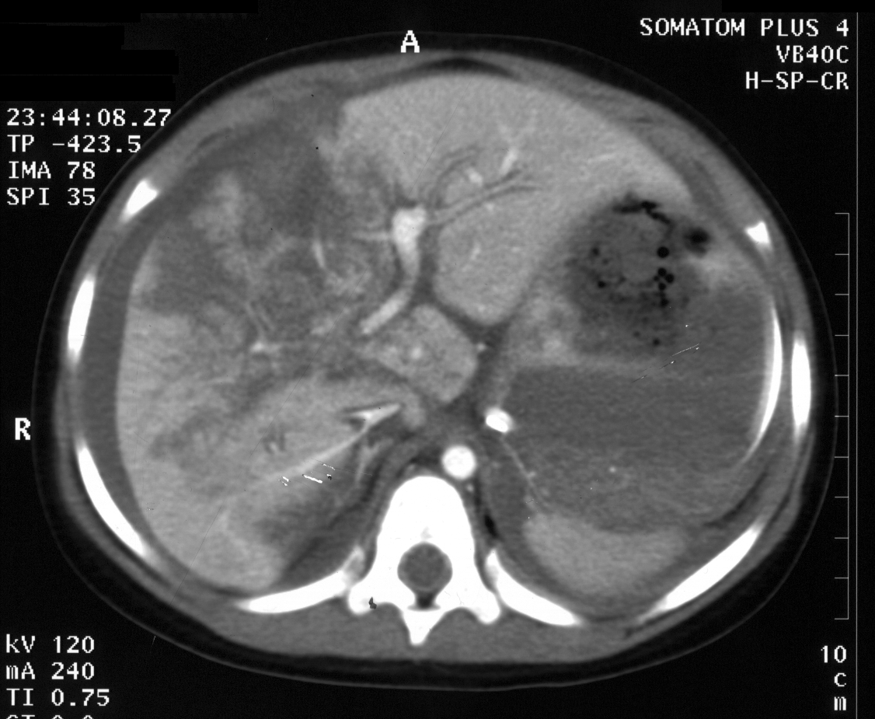

Slide 13
Trauma Exsanguination Protocol at HUP
Initial Response
  10 Units Uncrossed PRBCs
  4 Units Stored Plasma
  6 Pack Platelets
  Factor VII (surgeon discretion)

Slide 14
Addressing Coagulopathy
1:1:1 resuscitation?
  Military reports
  Minimize cystalloid
  Start platelet transfusion after 7-10 units of RBC
Factor VII?

Slide 15
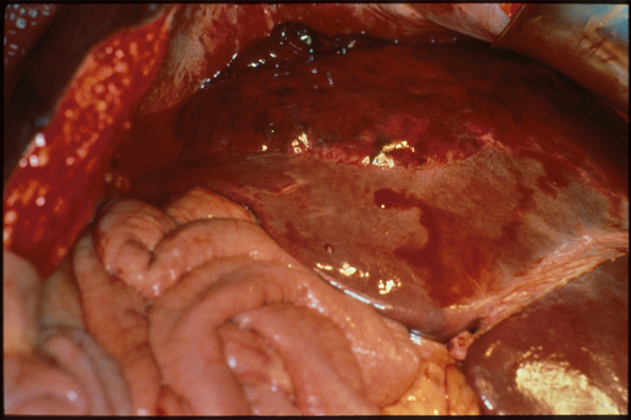

Slide 16
Treatment
Hemorrhage control
  Pack, Press, Pringle, Plug
Assess for intestinal injury – resect/close
Assess for pancreatic injury – drain
Assess for retroperitoneal injury – pack / plug

Slide 17
Perform angiographic control
Liver
Pelvis
Retroperitoneum
Deep muscle beds (gluteal, back thigh; no mesentery)
Consider temporary balloon tamponade

Slide 18
GUT
Suture
Staple
Tie off

Slide 19
Damage Control
Initial operation: < 2 hours
  Skin closure vs. open abdomen
  Definitive control of hemorrhage
  Control contamination
Resuscitation in ICU: 24 – 36 hours
Completion of surgical management of all injuries

Slide 20
Damage Control Part I
Closure
  Skin only: suture
  Open abdomen: temporary abd closure
    “vac-pack” most common
Leave the fascia alone…

Slide 21
TAC
Towel clip closure
Most rapid
Low cost
Maintains Abdominal domain
↓ heat/fluid loss
Ioban over clips

Slide 22
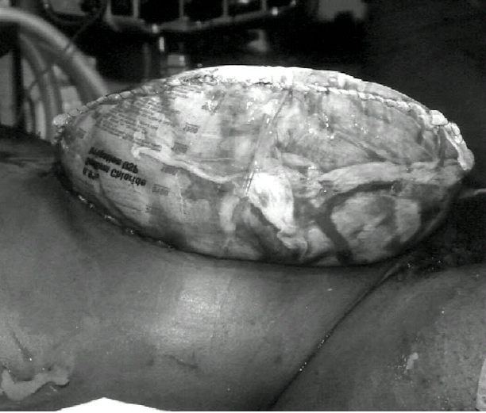
TAC
Bogotá Bag
Secure to skin
Inexpensive
Biologically inert
Large capacitance
Able to visualize bowel
Easy to remove
Partial control of fluid loss

Slide 23
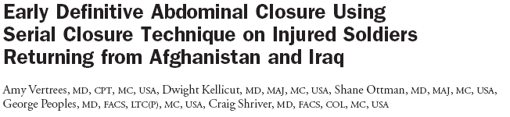
(JACS 2006)

Slide 24
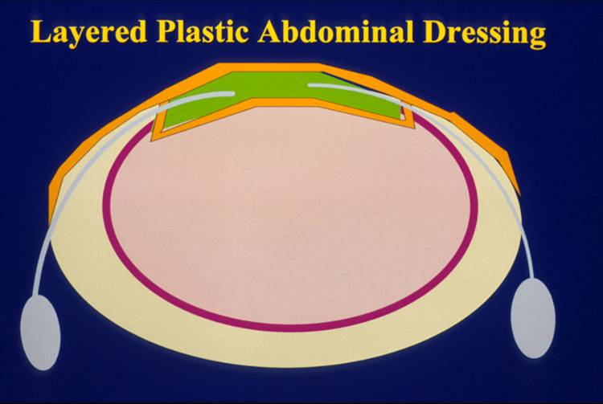

Slide 25
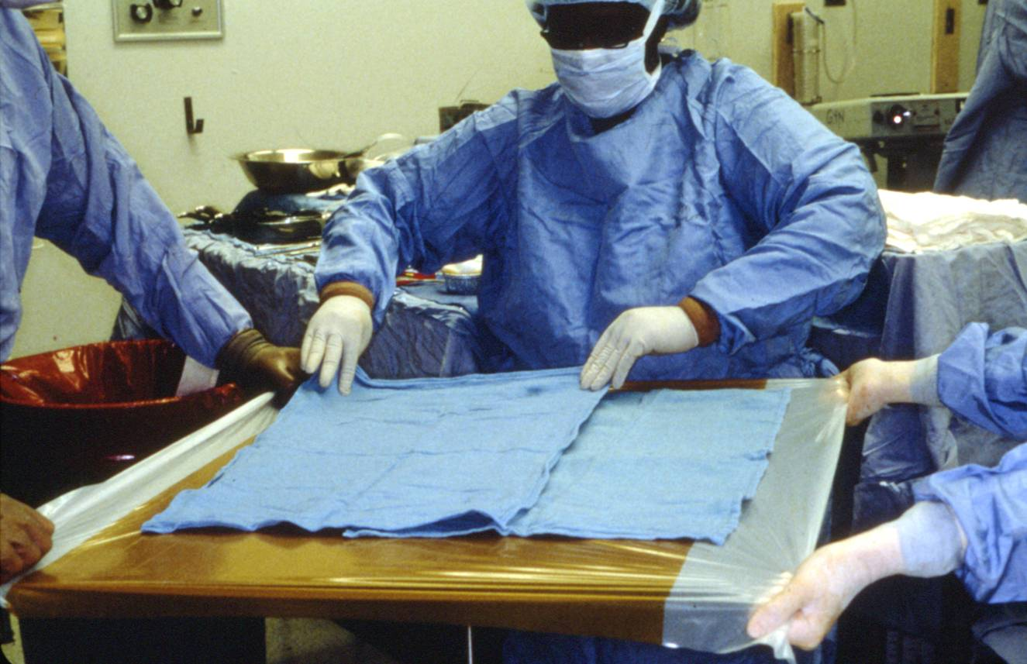

Slide 26
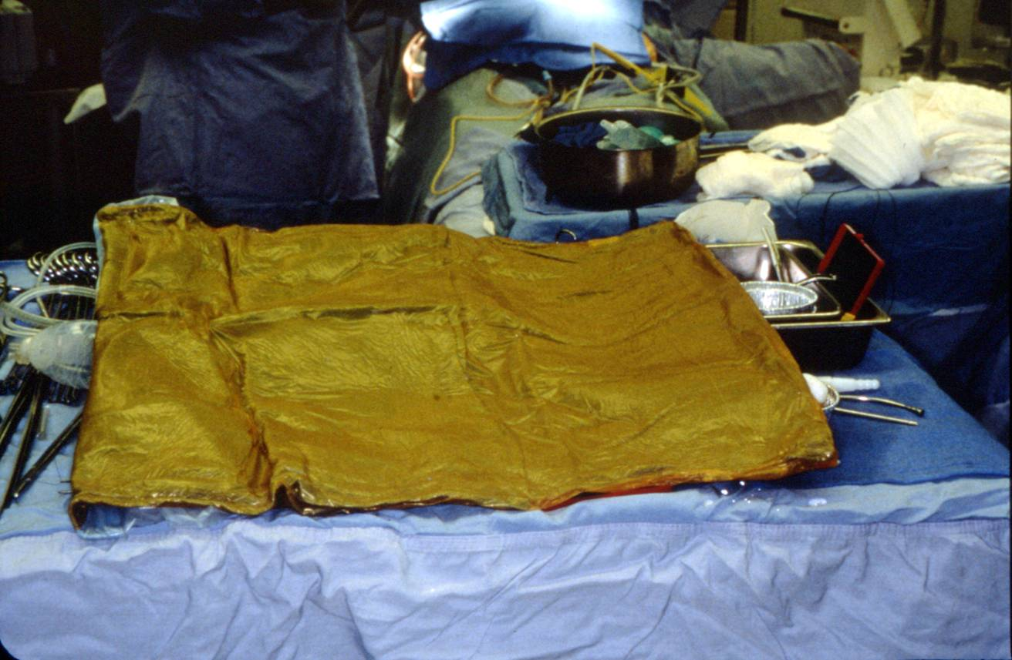

Slide 27
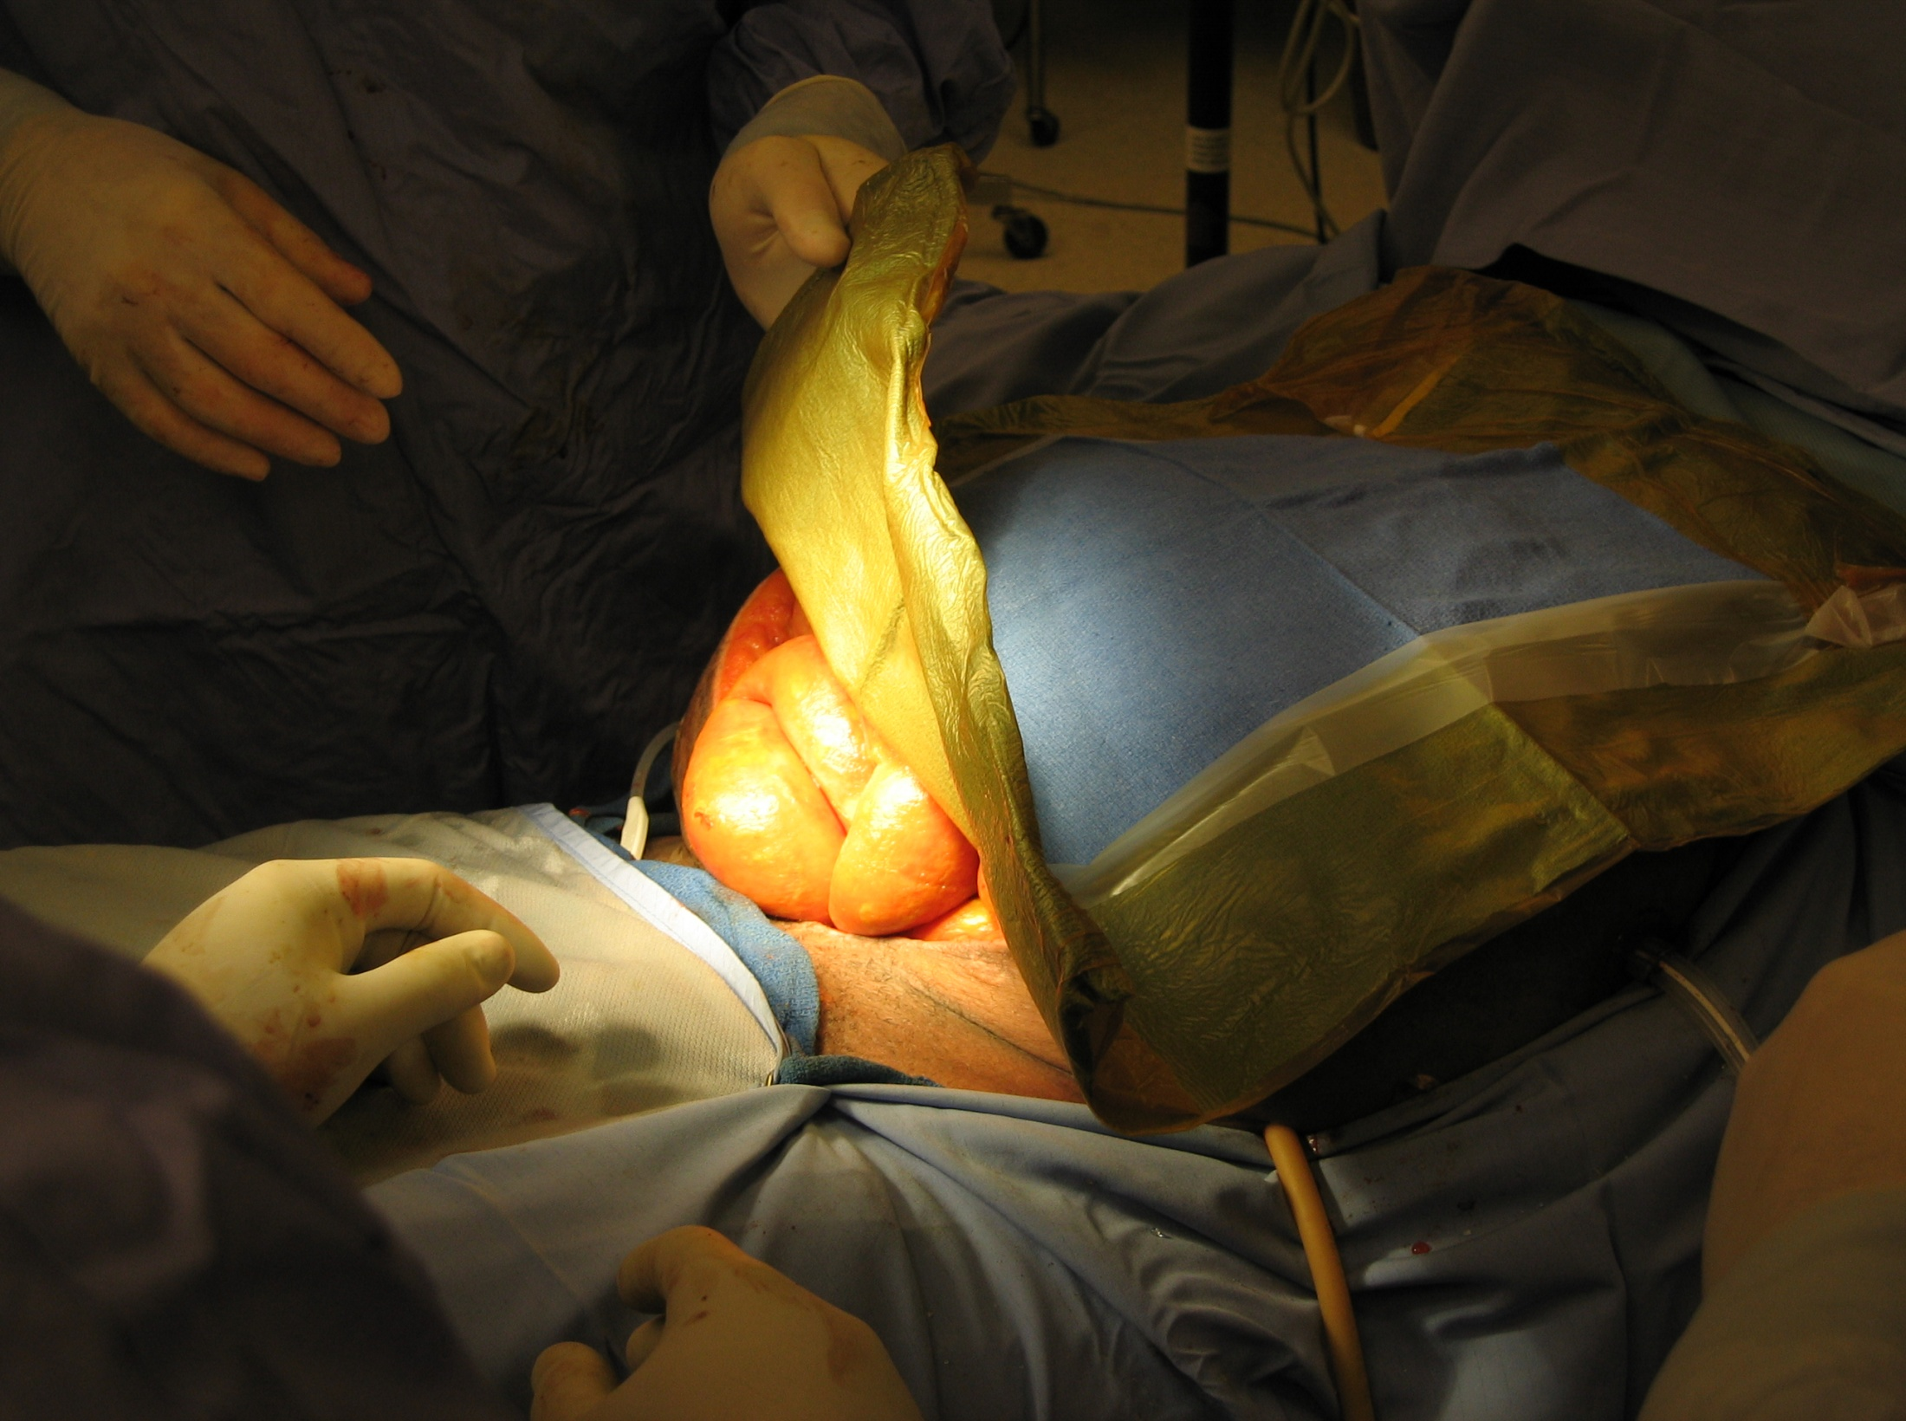

Slide 28
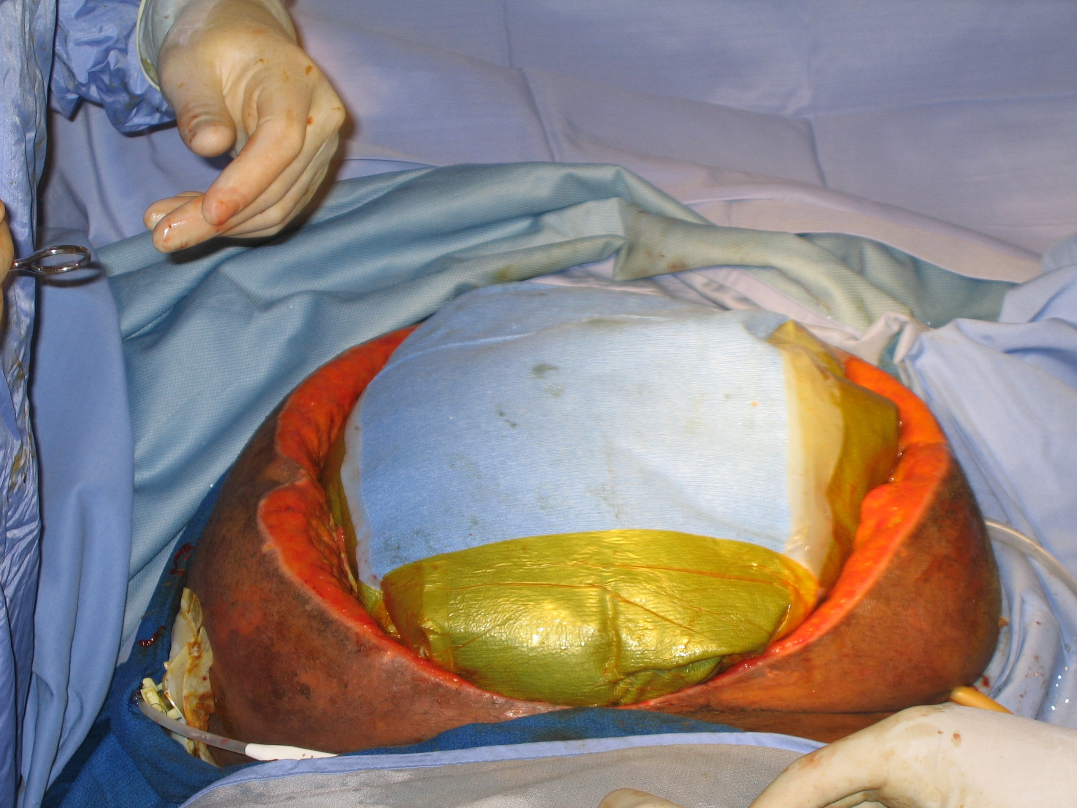

Slide 29
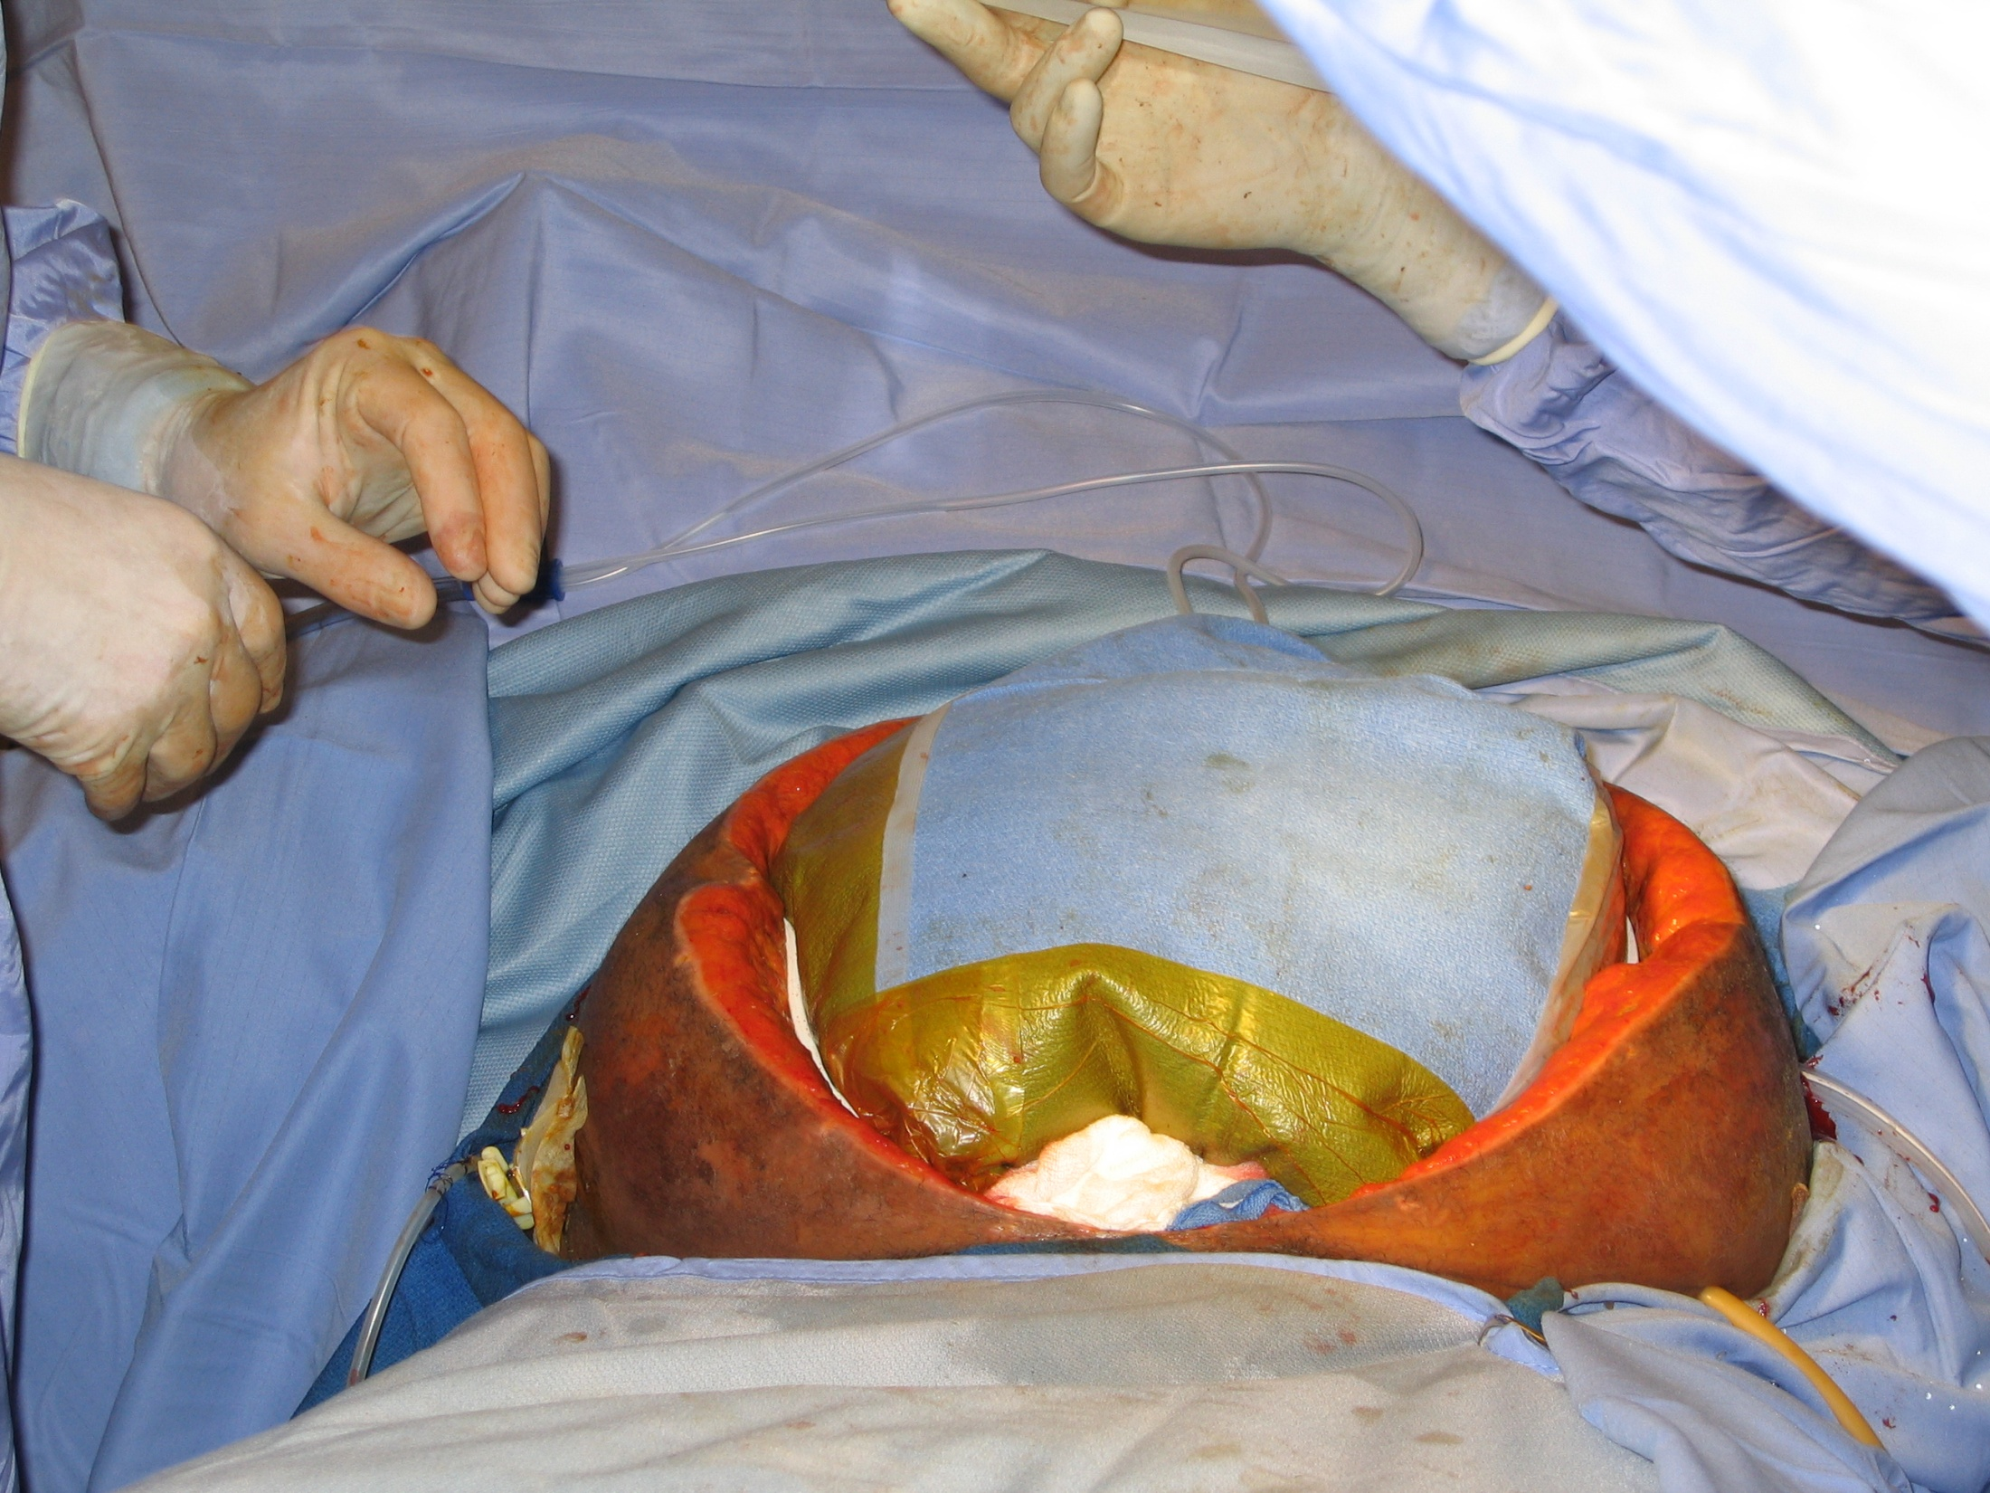

Slide 30
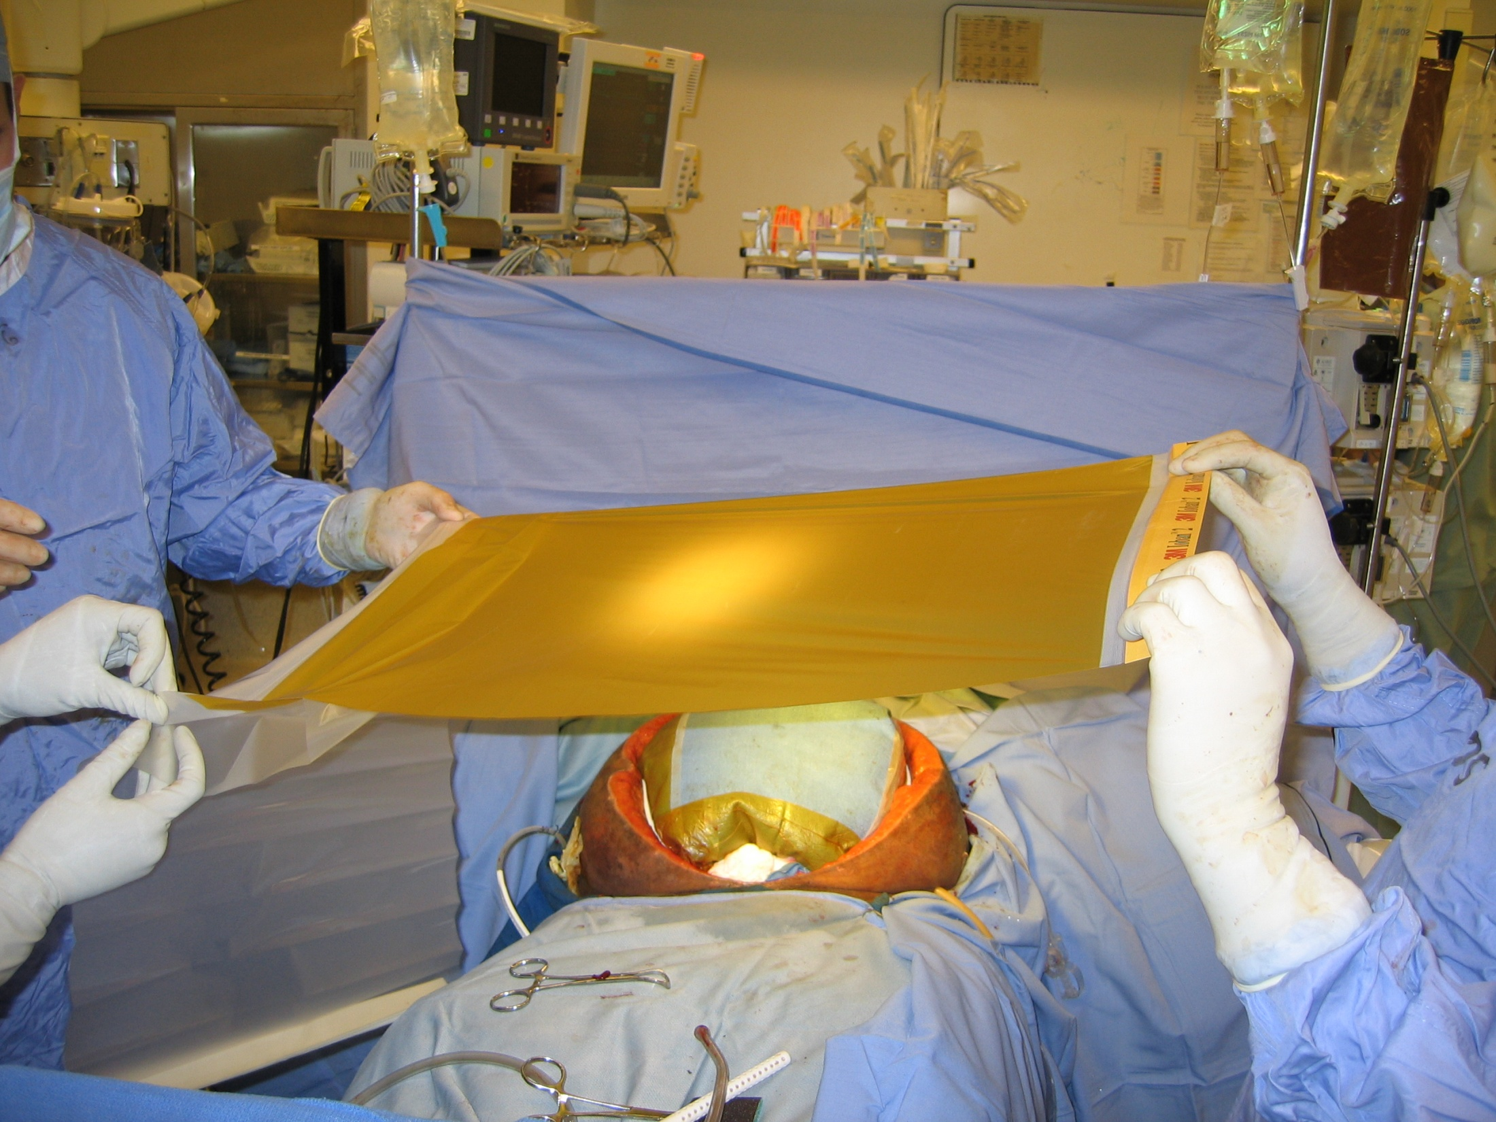

Slide 31
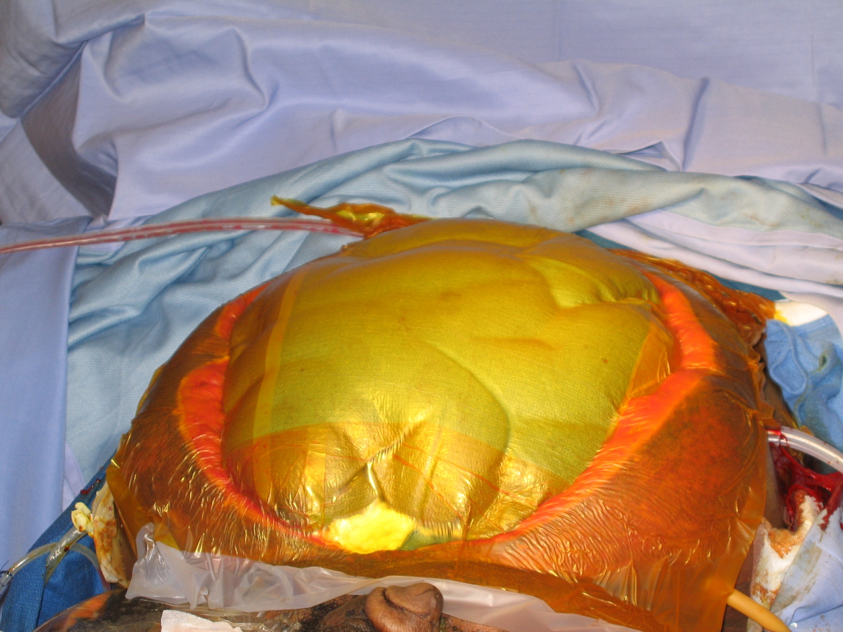

Slide 33

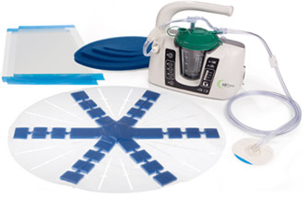

Slide 34
ACS in the Open Abdomen
Bulky abdominal packs
Continued bleeding into the abdominal cavity -uncorrected coagulopathy
        - unrecognized mesenteric vascular injuries
Bowel distension / Abdominal wall edema
from extensive resuscitation (> 10 liters)
High Mortality
Decompress immediately
Gracias,Braslow, et al Arch Surg 2002

Slide 35
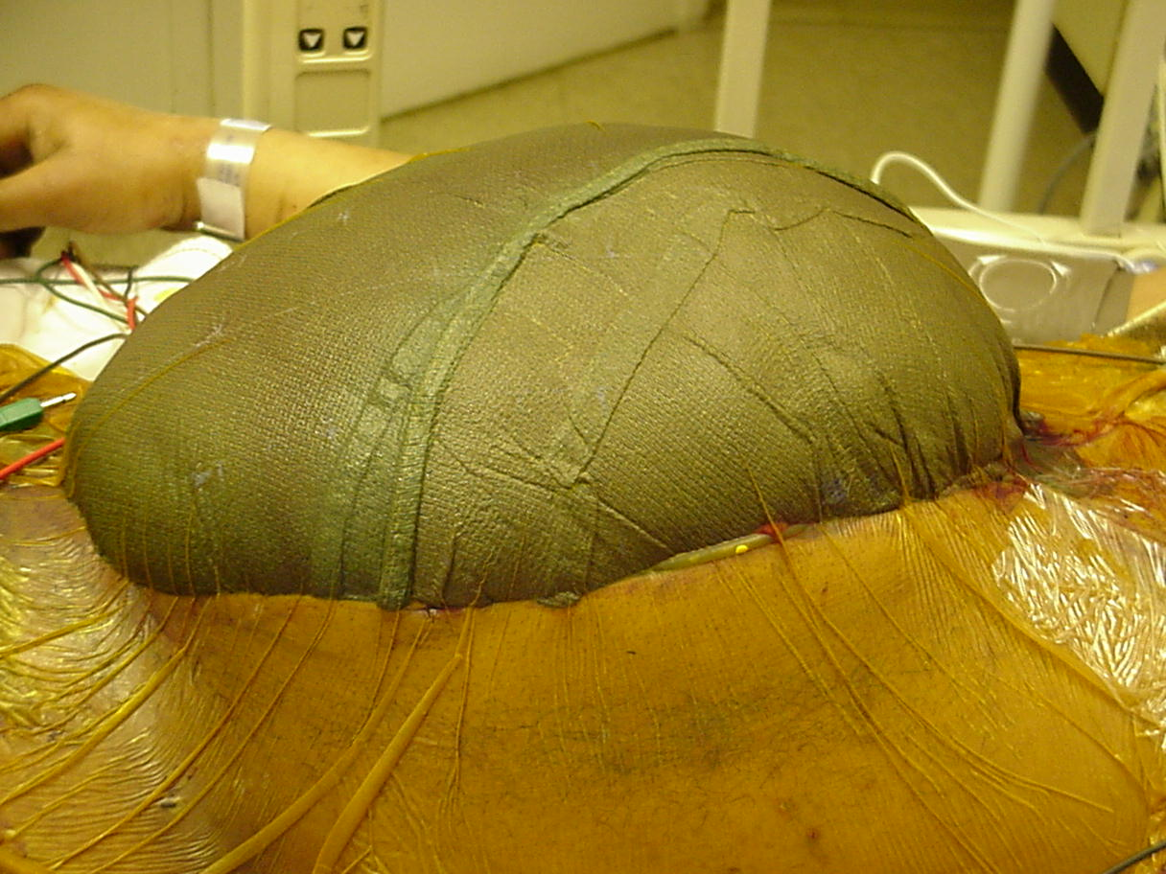

Slide 36
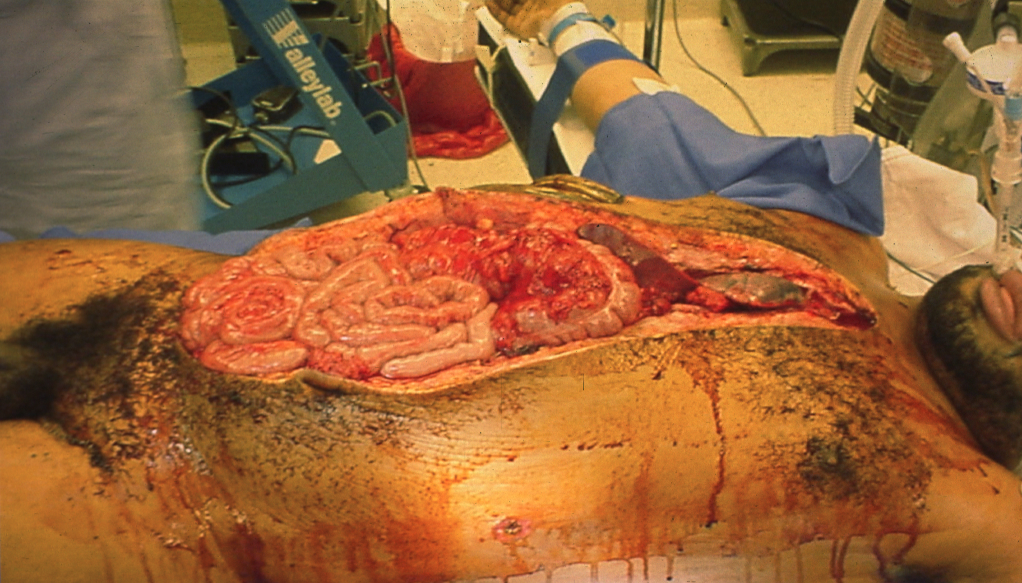

Slide 37
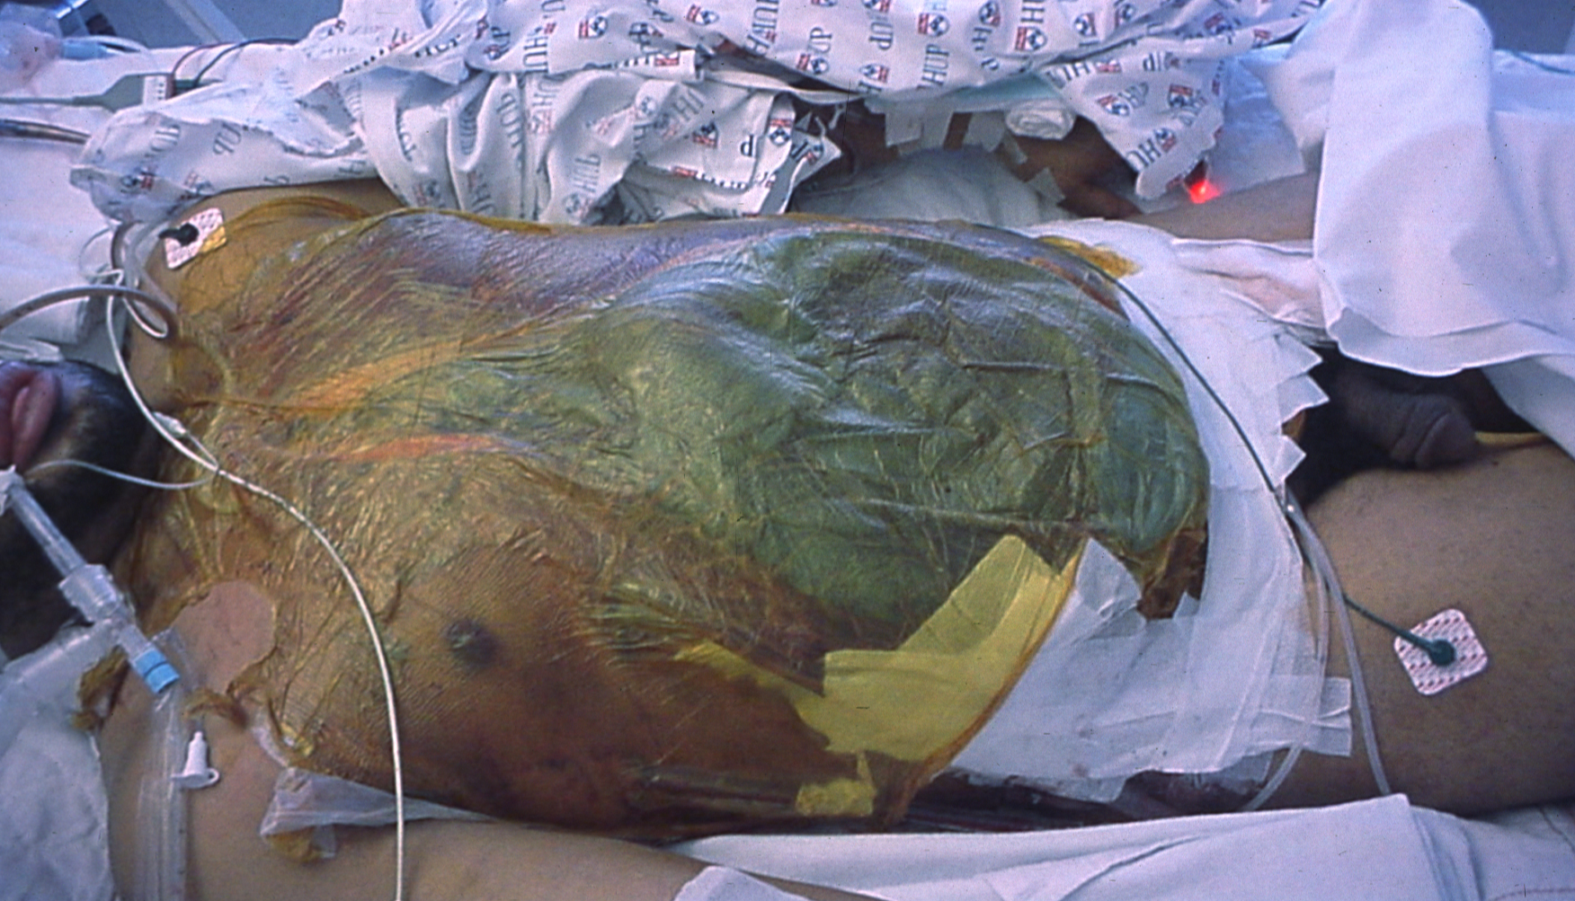

Slide 38
Damage Control
PART I - OR
Control hemorrhage
Control contamination
Intraabdominal packing
Temporary closure
PART III - OR
Pack removal
Definitive repairs
PART II - ICU
Core rewarming
Correct coagulopathy
Maximize hemodynamics
Ventilatory support

Slide 39
Damage Control
Part II - ICU
Rewarm
Support blood volume and coagulation
Re-examination
Abd Compartment Syndrome
Recruit consultants
Nutritional support

Slide 40
“Prolongation of the PT is the sentinel event…and occurs early in the operation”
J Trauma 2003

Slide 41
Nitrogen Balance in Open Abdomen
Estimate of 2g of nitrogen per liter of abdominal fluid output.
NB = N_{intake}- (UUN + 4 + (2 x Abd Fluid Output (Liters)) )
Cheatham et al. CCM 2007 vol.35, no. 1

Slide 42
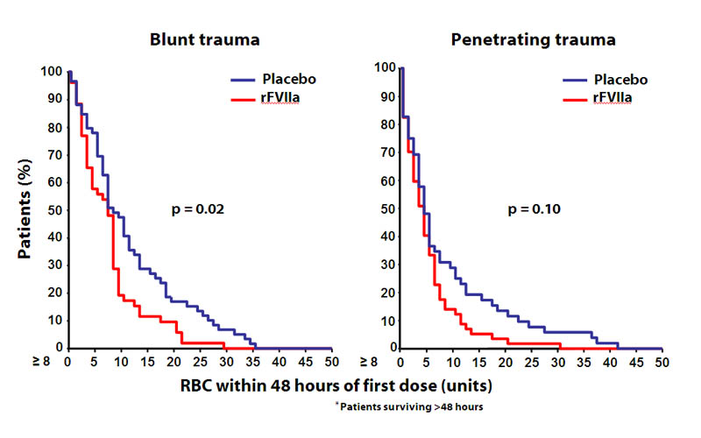
Factor VII in Trauma

Slide 43
Factor VII
Variable dosing
  90 micrograms/kg
  40 micrograms/kg
$20,000 direct cost
Half-life 2.5 hours

Slide 44
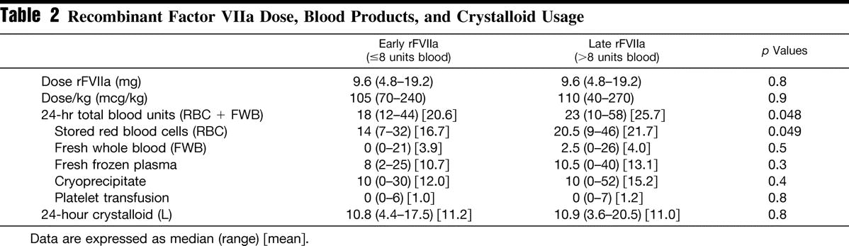
Factor VII - Timing
N=17
N=44
J Trauma 2007; 62 : 1095-1101

Slide 45
Factor VII in Trauma
Futile if:
  pH < 7.1
  Platelet < 50,000 cells/microliter
  PT > 17.6 seconds
  Lactate > 13 mg/dl
  RTS < 4
J Trauma 2005; 59: 609
J Trauma 2004; 57: 709

Slide 46
Notes:
Signs that pt needs to return for surgical bleeding. Surgical bleeding may develop in the ICU as the BP comes up and vasospastic arterioles open

Slide 47
Damage control – Part II
Mean ICU time: 31.7 hours
Arrival
Departure
pH
7.37
7.42
HCO₃
20.6
24.2
PT
19.6
13.3
PTT
70.4
34.9
Temp.
33.2
37.7
Rotondo. J Trauma 35 : 375; 1993
Notes:
Rotondo paper. 46 pts, GSW to the abdomen with massive transfusion. Decision to use DC based on surgeon discretion.

Slide 48
Damage Control
PART I - OR
Control hemorrhage
Control contamination
Intraabdominal packing
Temporary closure
PART III - OR
Pack removal
Definitive repairs
PART II - ICU
Core rewarming
Correct coagulopathy
Maximize hemodynamics
Ventilatory support

Slide 49
Damage control
Part III – Back to the OR
Peritoneal irrigation
Definitive Arterial - venous repair
Bowel resection and anastomosis
Colostomy
Liver debridement, resection or suture
Feeding tubes
Abdominal wall closure

Slide 50
Stoma Preparation in the Open Abdomen

Slide 51
Feeding Tubes in the Open Abdomen

Slide 52
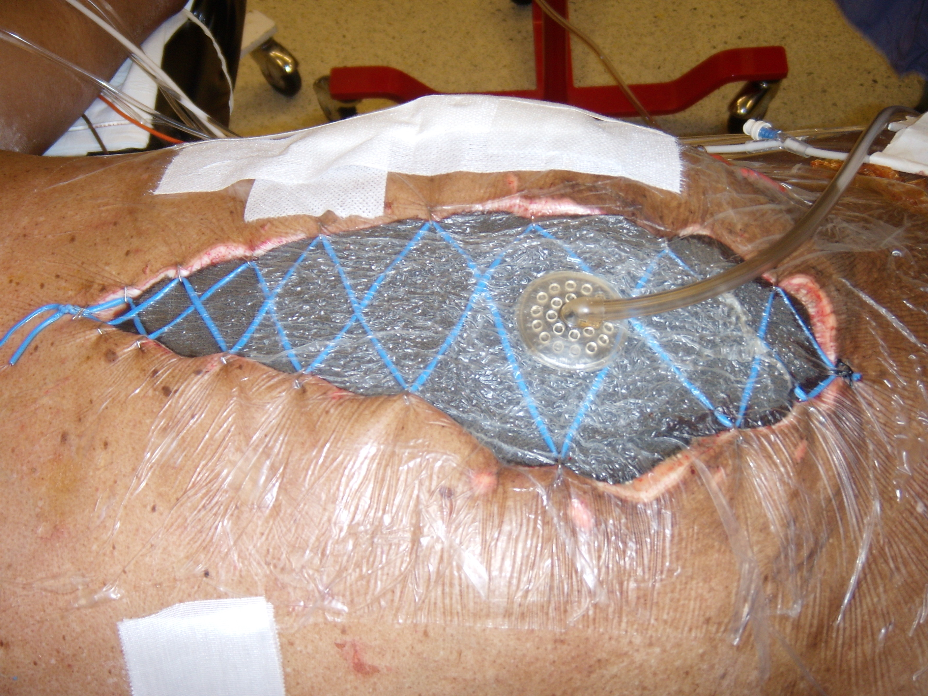
Primary Fascial Closure
50 – 65 %
*Recent Penn 57 %
    All within 8 days
Vanderbilt 57%
Wake* 88%
    VAFC
    Average 9 days
        1-21days

Slide 53
Complications in the Open Abdomen
Abdominal compartment syndrome
Nitrogen Loss
Fistula 2 – 20%
  Enterocutaneous
  Enteroatmospheric
Abscess 12%
Dehiscence
Inability to obtain fascial closure
Notes:
Almost 100% of all damage control pts will have some sort of complication (medical or surgical).
25% will have one of the surgical complications noted above

Slide 54
Risk Factors –
Enteroatmospheric Fistula
Delay in primary closure
  > 8 days: complication rate ↑ from 12% to 52% (p<0.0001)
Anastomosis - technique
Exposed suture lines
? Multiple washouts, multiple hands
Miller RS, J Trauma, 2005;59:1365-1374
Notes:
All the factors that predispose to the development of an enterocutaneous fistula apply to the development of an enteroatmospheric fistula. Although life saving,with the more liberal use of damage control surgery with its resultant “open” abdomen comes at a price.
In a 7 year retrospective review of 344 damage control celiotomies in trauma, Dr. Miller at Vanderbilt report that of the 276 patients that survived to wound closure, 25% suffered wound complications such as infection, abscess or fistula formation. These complications increased significantly if the abdomen was left open for more than 8 days with the median time to fistula formation of 21 days.
The open abdomen presents some unique difficulties in the sense that a relatively delicate tissue is exposed, there is constant fluid loss, and the host is typically compromised. Suture lines that exposed to the ambient environment are at increased risk for breaking down. The delicate bowel is at risk for repeated debridment and desorosilzation, there is risk for dessication and tissue loss. And with multiple washouts with multiple different teams, there is the risk for iatrogenic injury.

Slide 55
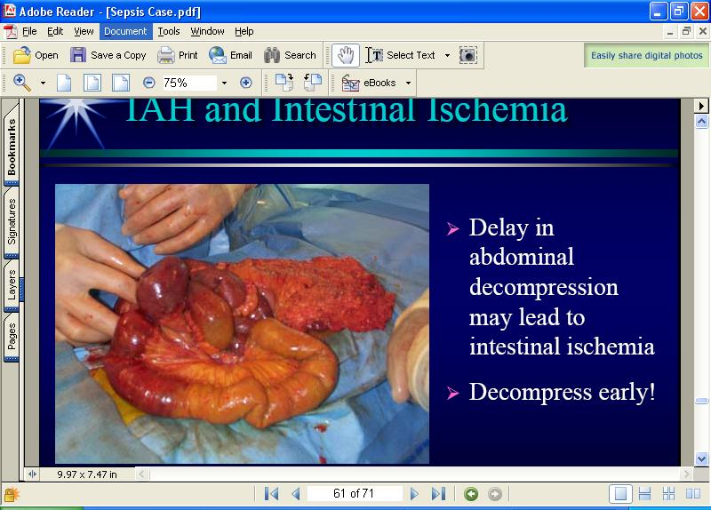
Anastomosis and Fistula
Hand sew vs. staple??
Bury/Plicate deep in the abdomen
Cover with other viscera
Save and use the omentum.
Avoid feeding tubes.
XX
O

Slide 56
Fistula Prevention
Stapled vs sutured anastomosis:
  Retrospective review of 5 Level 1 centers
  175 stapled vs 114 hand-sewn
    Leak: 7/175 vs 0/114 (p=0.04)
    Abscess: 19/175 vs 4/114 (p=0.04)
    No difference in enterocutaneous fistula
    Large bowel: 20% vs 4% complication rate
    Small bowel: 7% vs 2% complication rate
Brundage SI, J Trauma, 2001;51:1054-1061
Notes:
Stapling devices in surgery quite prevalent now and many would consider this method standard in general surgery. In the nonacute setting, there is no significant differences in the complication rate b/w handsewn and stapled anastomosis.
Designed for normal bowel
After introduction of this technology on the trauma service at the university of washington, noticed an increased rate of complications in their stapled anastomosis.
This lead to a retrospective reivew of trauma registires at 5 different level 1 trauma centers over a period of 4 years.
Pts were similar in ISS and abdominal AIS and did not differ in mechanisms
However, large bowel injuries were possibly more severe in the stapled group – only 6/32 could be graded in the stapled and whereas 22/29 could be graded in the hand sewn. Colonic injuries had higher OIS with stapled anastomosis, but small bowel did not.
Given that leaks and abscess are associated with increased risk for fistula, these complications could predispose to the formation of fistula.
No mention of who was left with an open abdomen
Raises the question that maybe trauma patients should have hand-sewn anastomosis especially if the large bowel is injured – and potentially all anastomosis if the abdomen is to be left open.
No consensus as of yet.

Slide 57
When a fistula forms…
Historical Outcomes
Most of enterocutaneous fistula close w/in 8 weeks
  r/o traditional causes.
Minimal closure of enteroatmospheric fistula
    Protruding mucosa
    Multiple
Notes:
Historically, with this conservative management 30% of enterocuteanous fistulas will close within 8 weeks.
Enteroatmsopheric fistulas, on the other hand, have absoluately no tract between the air and the bowel and as a consequence have minimal closure. Overall the mortality associated with having an enterocutaneous fistula is 10-30% depending on coexisiting conditions.

Slide 58
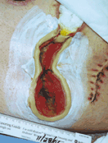
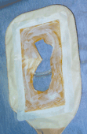
ECF Historical Outcomes
“Standard Rx”:
* Treat infxn/drain
* Fluid electrolyte resuscitation
* Nutritional support
* Bowel rest +/-
Wound management
    Protect skin
    VAC
Notes:
Work up includes a CT scan to evaluate the possibility of an abscess that could be drained and treated with antibiotics.
Dehydration and 3rd space fluid and electrolyte losses can be profound and if not recognized, the patient can progress to acute renal failure or shock. Prompt resuscitation with isotonic fluids and correction of electrolyte disturbances are a crucial first step in the management of these patients
Along those lines, H2 blockers are given in order to decrease the amount of fluid secreted by the GI tract and decrease the potential for excessive fluid loss.
Strict bowel rest with the idea that if you decrease the amount you put in, you decrease the amount that comes out of the fistula – decreased output theoretically increases the likelihood that the fistula will close
And aggressive wound management – this is actually key, because enteric contents are like acid and they can progressively eat away the tissue adjacent to the fistula – Historically, wound management has relied on various different dressings that could absorb the enteric contents, application of various goos and stoma pastes and the creation of wound manager bags.

Slide 59
Attempt to Seal Leak: EAF
Things NOT to do:
  - place a well meaning stitch
  - intubate the “floating” fistula orifice in an attempt to “control” leak
  - acutely resect and start fresh
  - give up hope!
Notes:
Nothing worse – and you feel that you have to do something - resist the temptation and remember that less is more. Specifically -

Slide 60
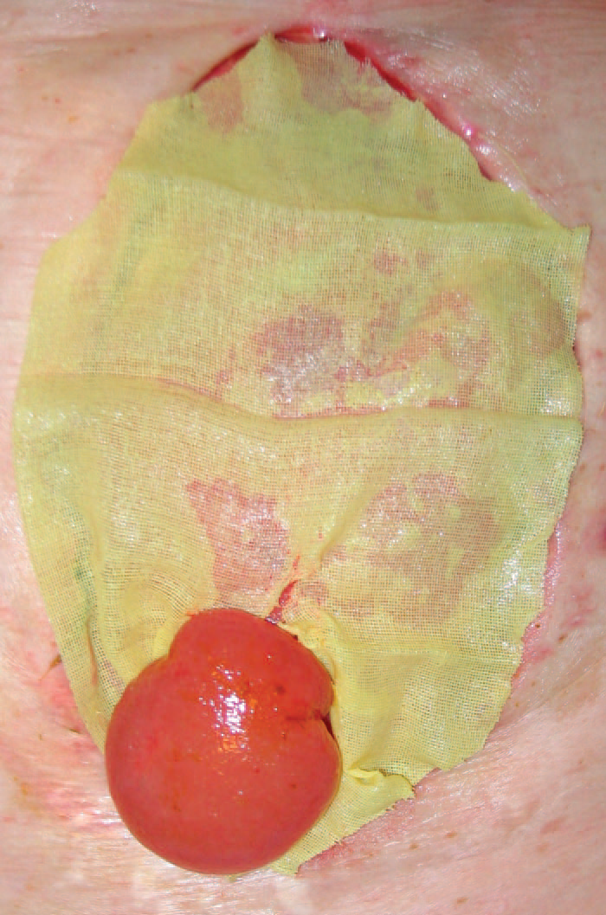
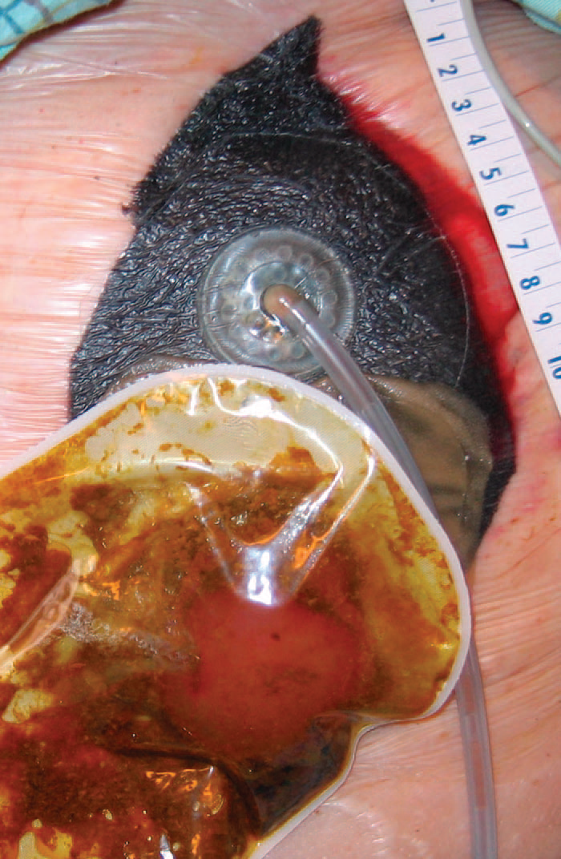
Control Fistula
The “Fistula VAC”
  - protect granulation
  - ostomy to gravity
  - pre/post STSG
  - thicken contents
Goverman J, J Trauma, 2006;60:428-431

Slide 61
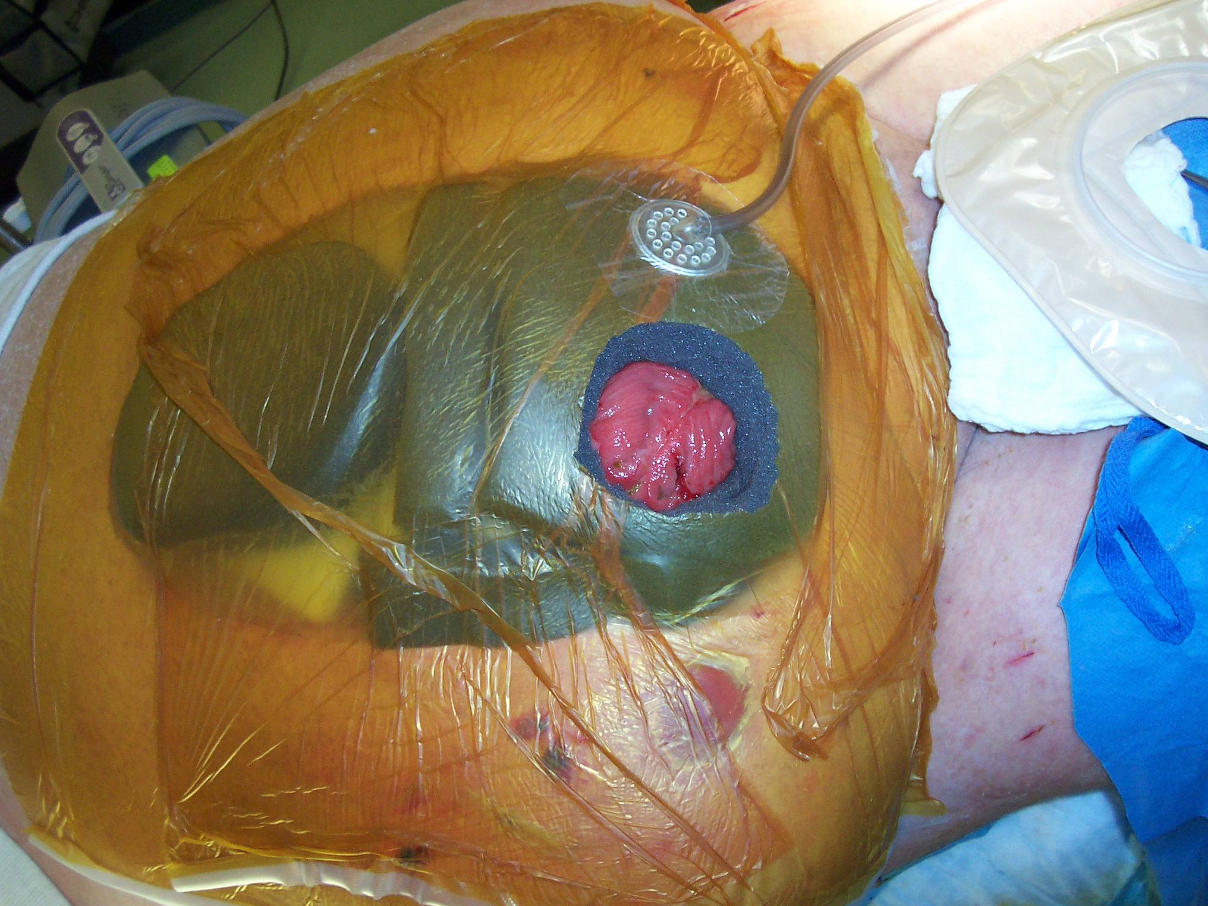

Slide 62
The Open Abdomen
Failed staged approximation of fascia
Encourage granulation
  Vicryl Mesh
  VAC therapy alone
  Requires 7-14 days

Slide 63
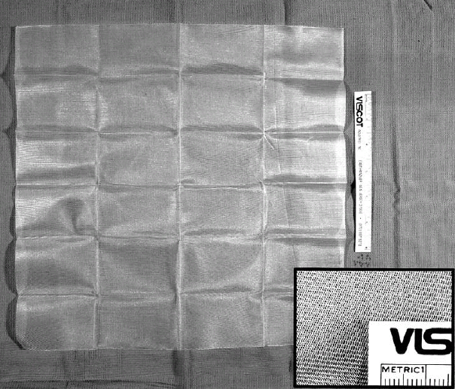
DC-III
Close fascia if able
Absorbable mesh, Wittmann Patch, ePTFE
Secure to fascia
Late hernia
Large evaporative fluid loss
No further procedures acutely
Notes:
DC-III Abdominal Closure using Vicryl mesh or STSG directly onto bowel

Slide 64
Notes:
With or without a fistula, the goal is to obtain granulation tissue to STSG in cases where the abd cannot be closed

Slide 65
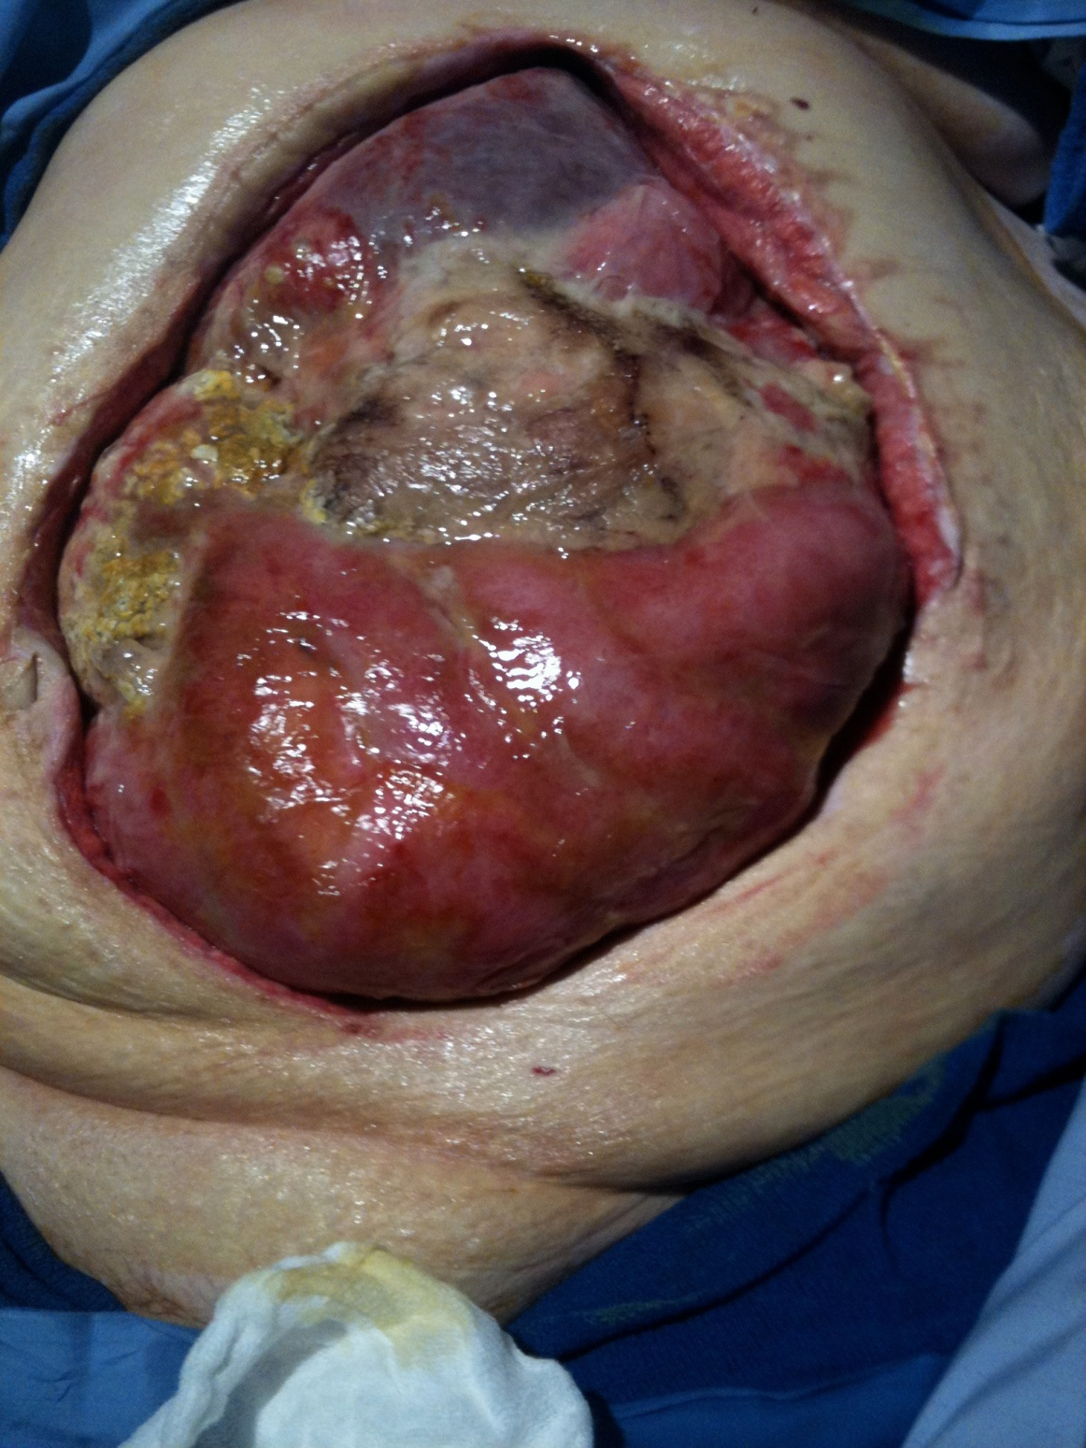

Slide 66
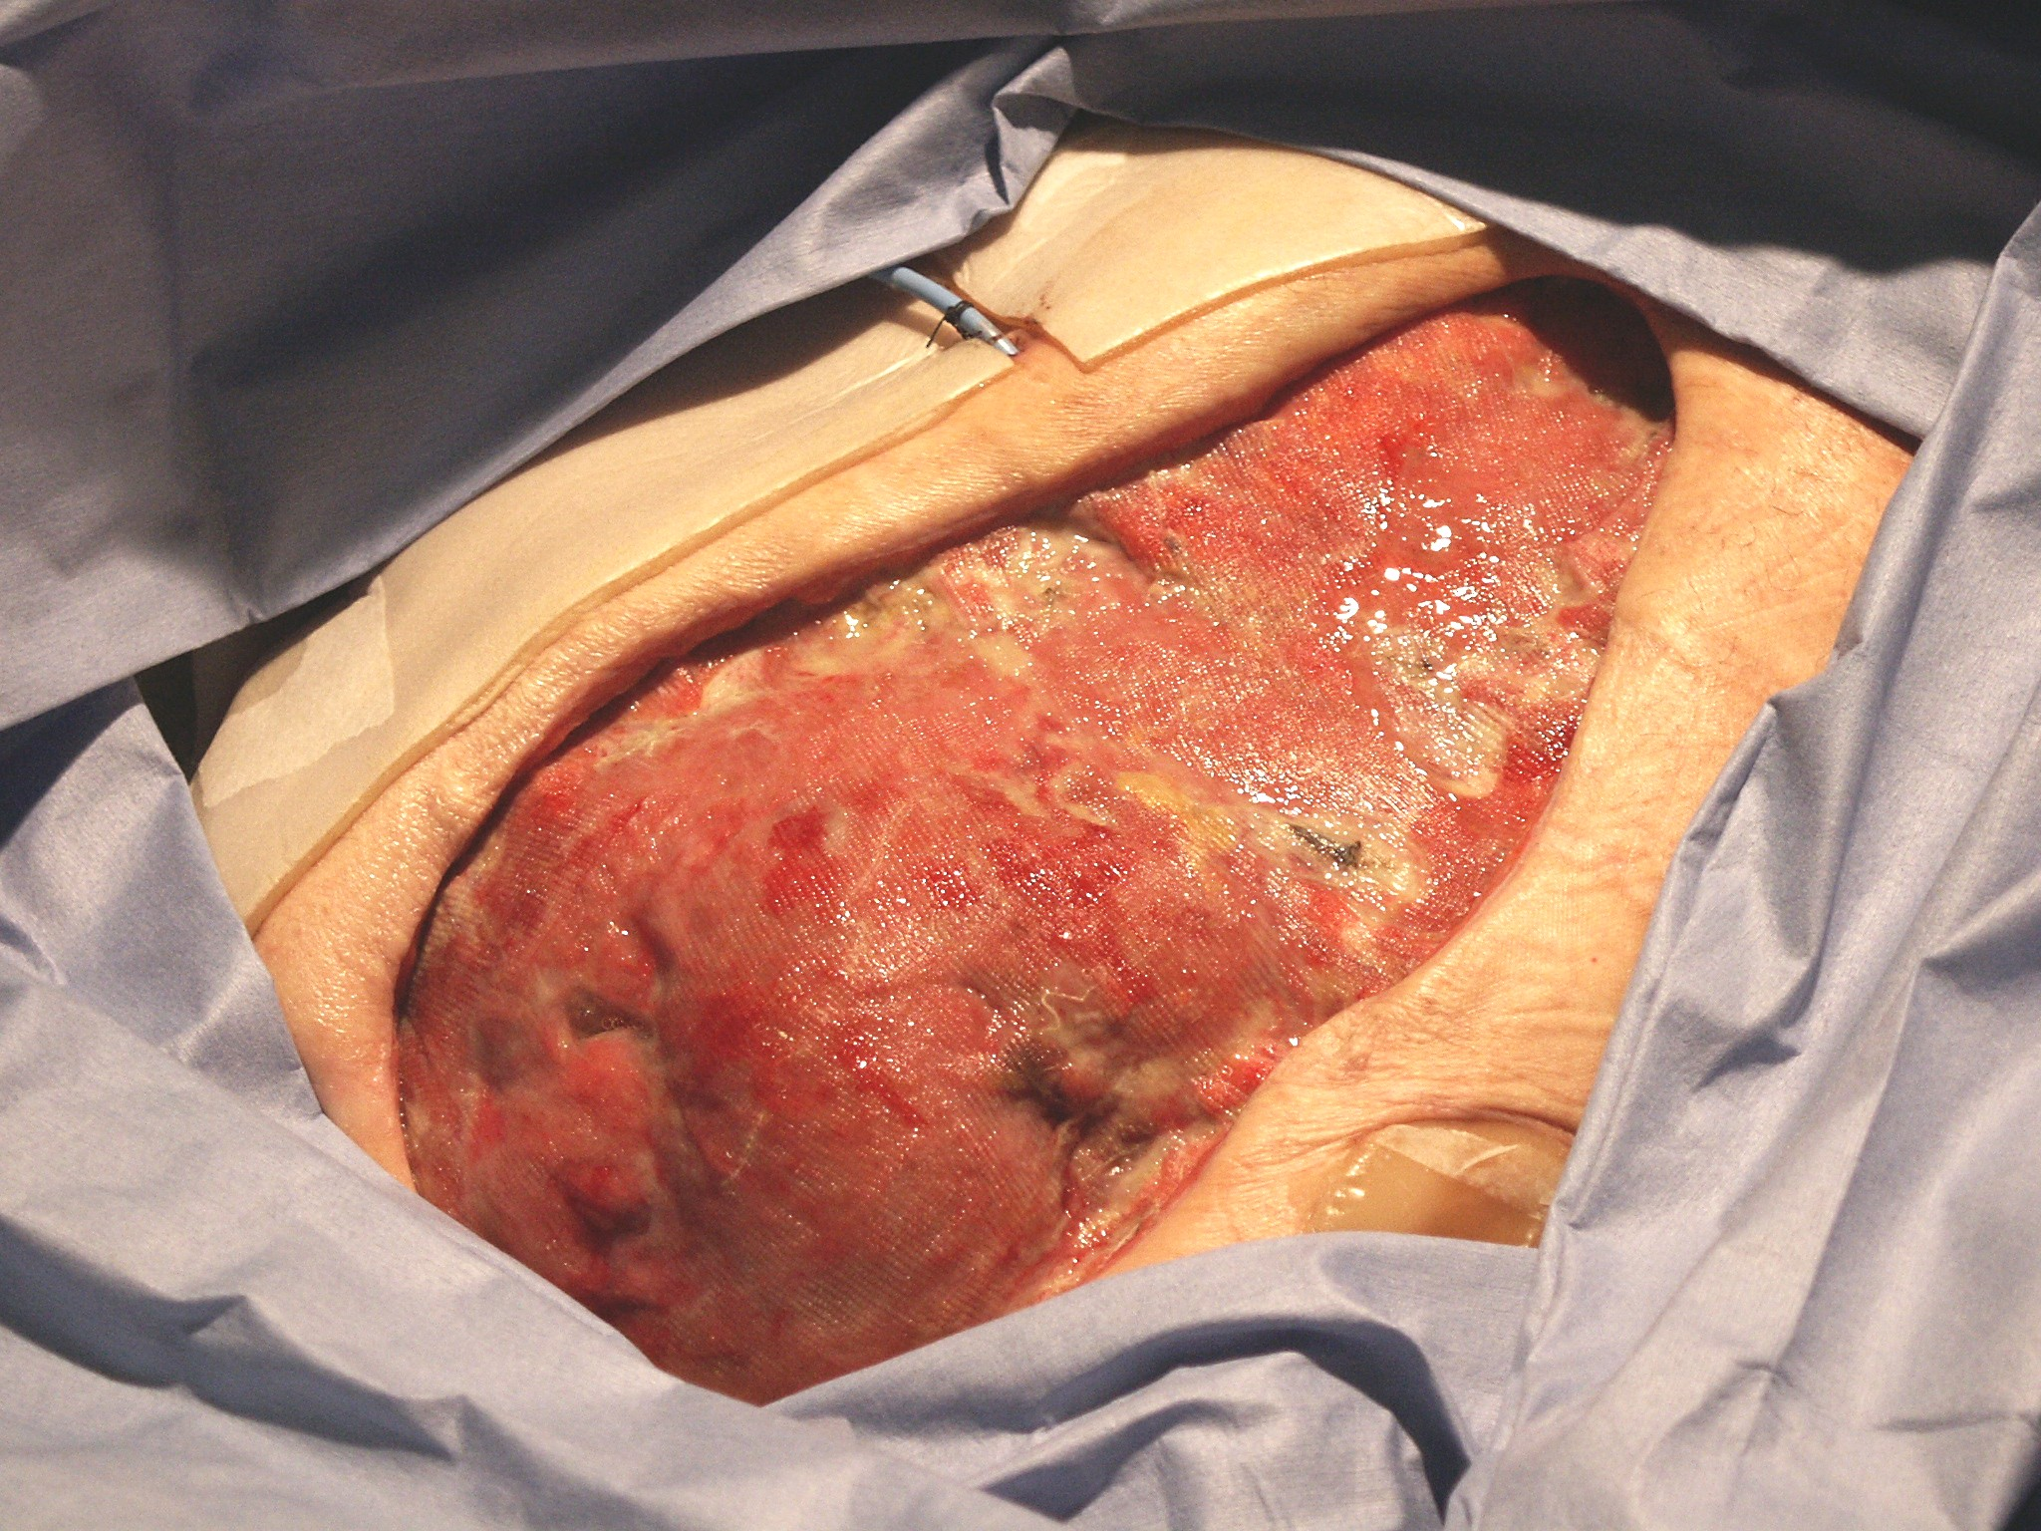

Slide 67
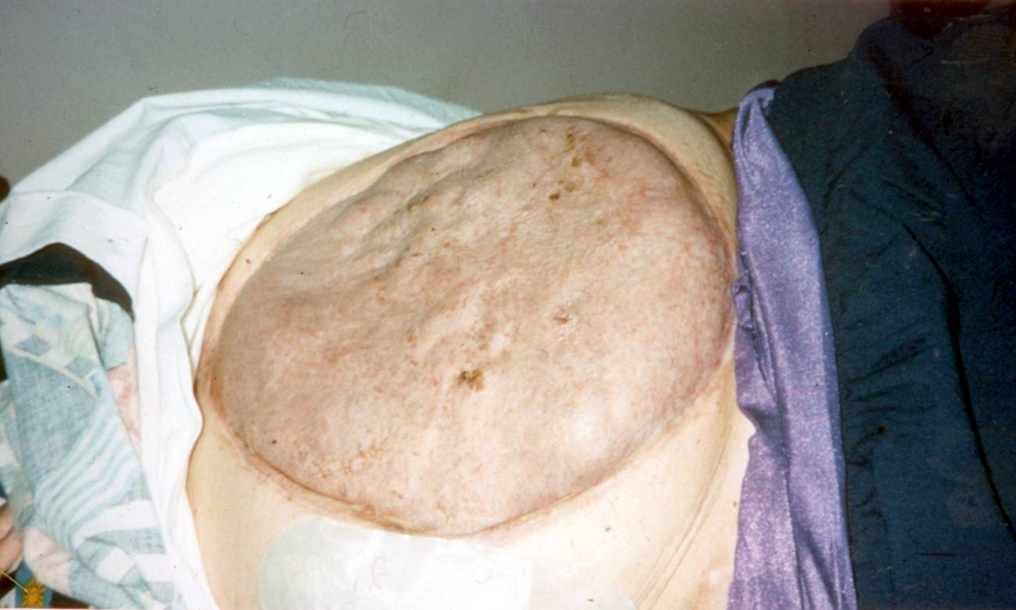

Slide 68
Damage Control Sequence
DC0 “Ground zero” - Recognition
DC I – OR (warmed)
Rapid transport (EMS)
Decision ----> OR
Resuscitation (TB)
  O2, Blood, Prevent heat loss Massive transfusion protocol
Control hemorrhage
Control contamination
Intraabdominal packing
TAC
Minutes
< 2 hrs
DC II - ICU
Rewarming
Correct coagulopathy
Maximize hemodynamics
Ventilatory support
Re-exam
DC III - OR
~24-36 hrs
Pack removal
Definitive repairs
Closure ?
DC IV - OR
Definitive Closure
48hrs –1yr
Johnson, Gracias, Schwab, et al. JTrauma 2001.

Slide 69
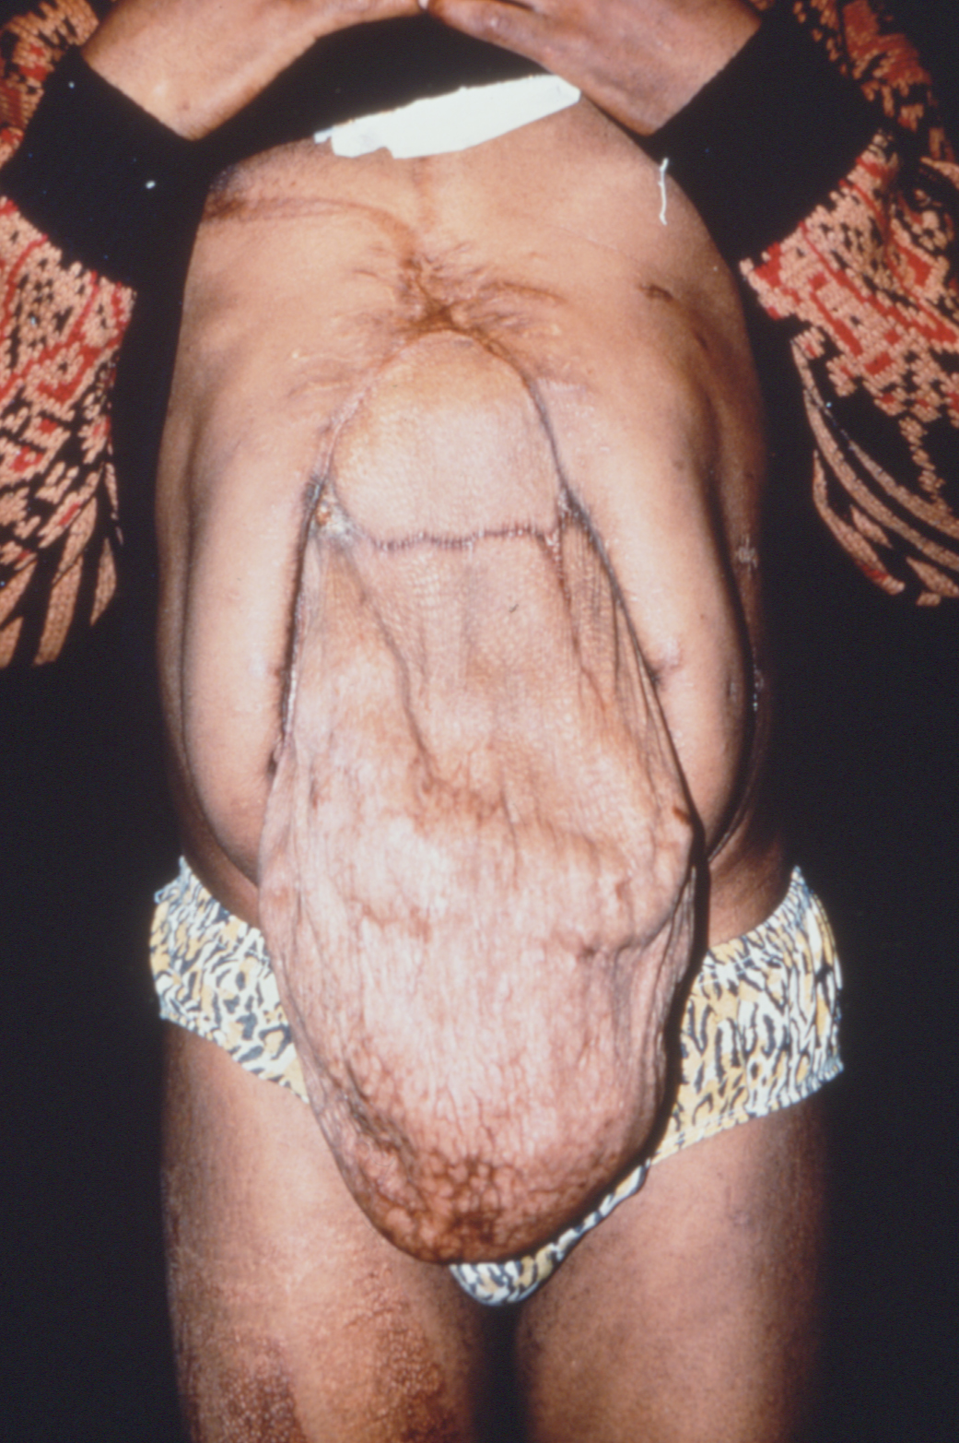

Slide 70
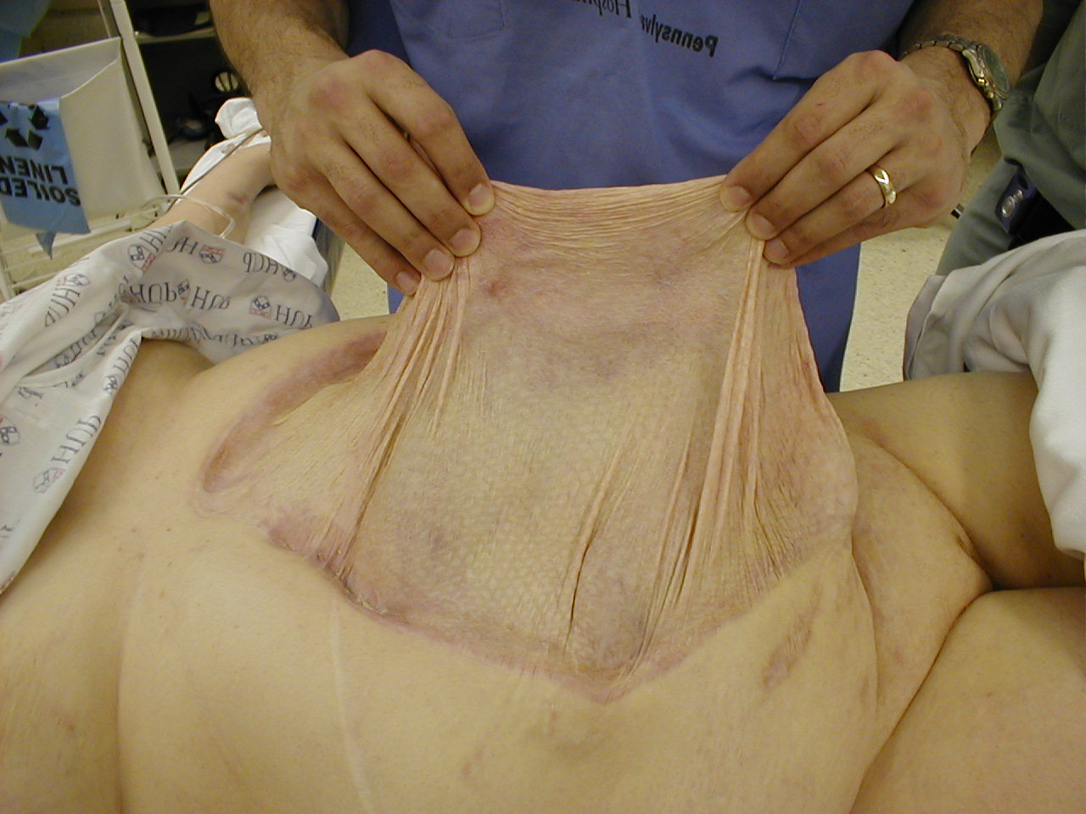

Slide 71
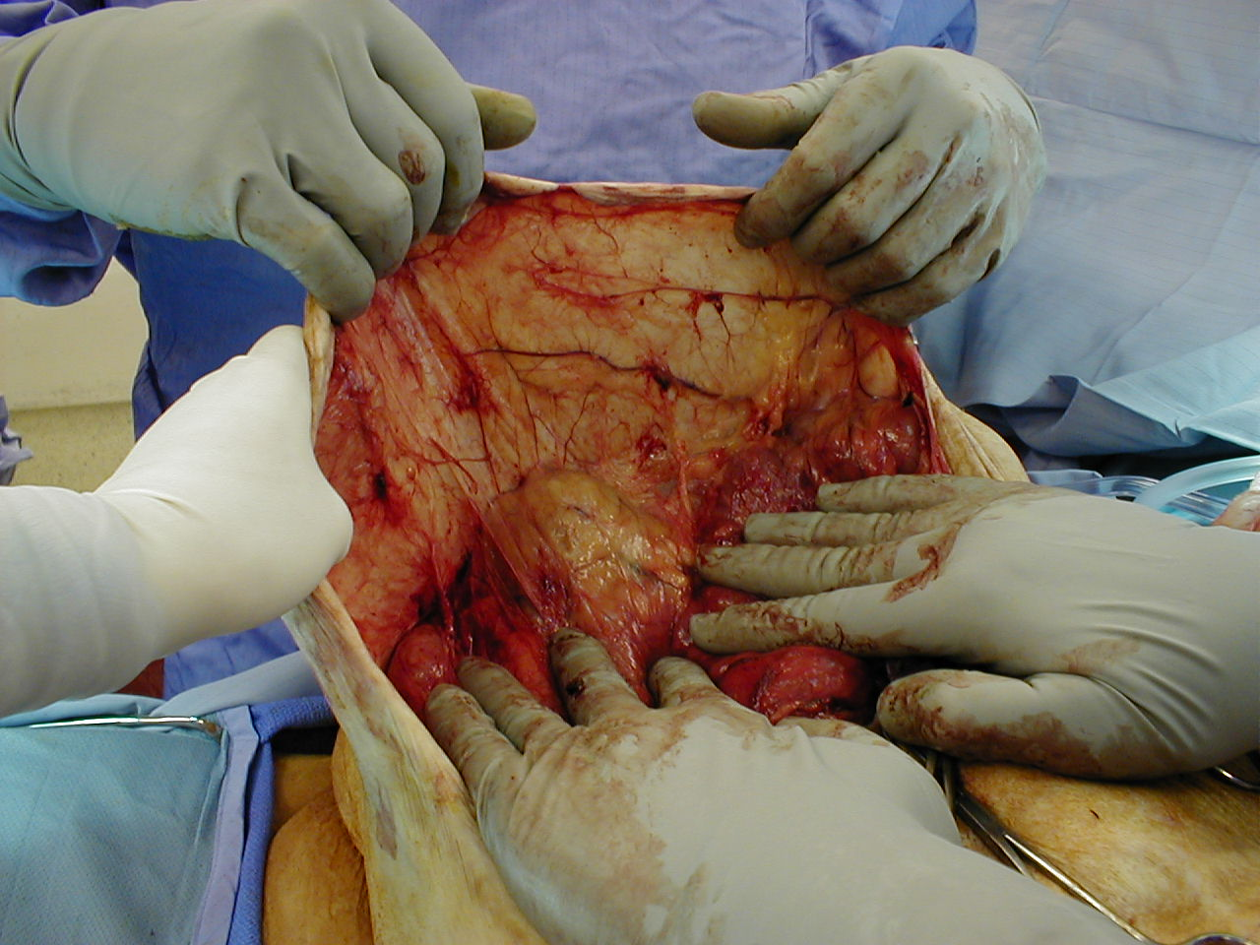

Slide 73
May use underlay mesh as buttress
Vicryl or Biologic

Slide 74
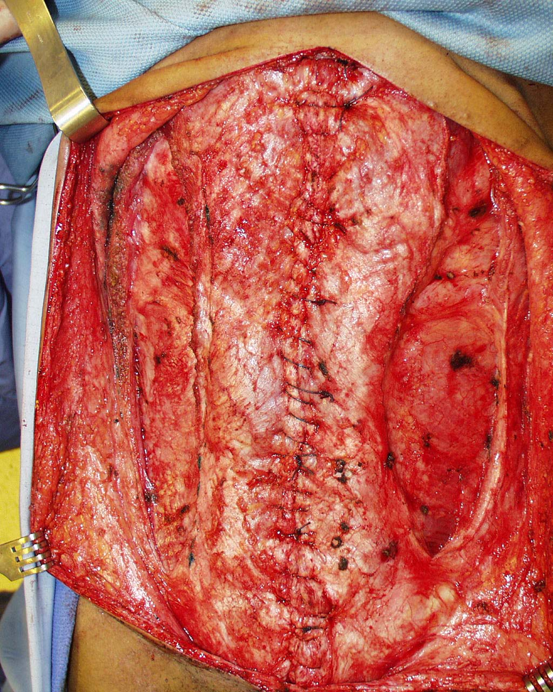

Slide 75
So Does it Work?
No RCT
Stone (1983)
  35% reduction in mortality following onset of coagulopathy
Rotondo
  77% reduction in mortality with combined vascular/visceral injuries
Stone Ann Surg 197:532; 1983
Rotondo J Trauma 35:375; 1993
Notes:
Rotondo paper is retro review of 46 pts, 3 yrs, GSW to the abdomen requiring massive transfusion. Has a control arm. Surgeon discretion to use damage control.
Stone paper is retro review of 31 pts.6 yrs, before/after adoption of this technique. DC used when intraop coagulopathy noted (clinical). 77% penetrating.

Slide 76
Evolution of Damage Control
Vascular – temporary shunts
Orthopedics – external fixation
Neurosurgery – craniectomy, early decompression and posterior/external fixation
Cardiac – Open Chest
Resuscitation – minimize cystalloid, Plasma Based
Notes:
The term damage control has now expanded to include the sum total of the maneuvers needed to maintain life above all else.

Slide 77
Future Challenges
What to do with the unclosable abdomen
The ideal mesh product
  Relatively inert/minimal inflammation
  Non adherent to bowel/viscera
  Very small porosity
  Water/small protein permeable
  Resists infection
  Dissolves in 2-3 weeks leaving granulation behind
  Strong

Slide 78
Recommended Reading
Injury 2004; volume 35
  Dedicated to damage control

Slide 79
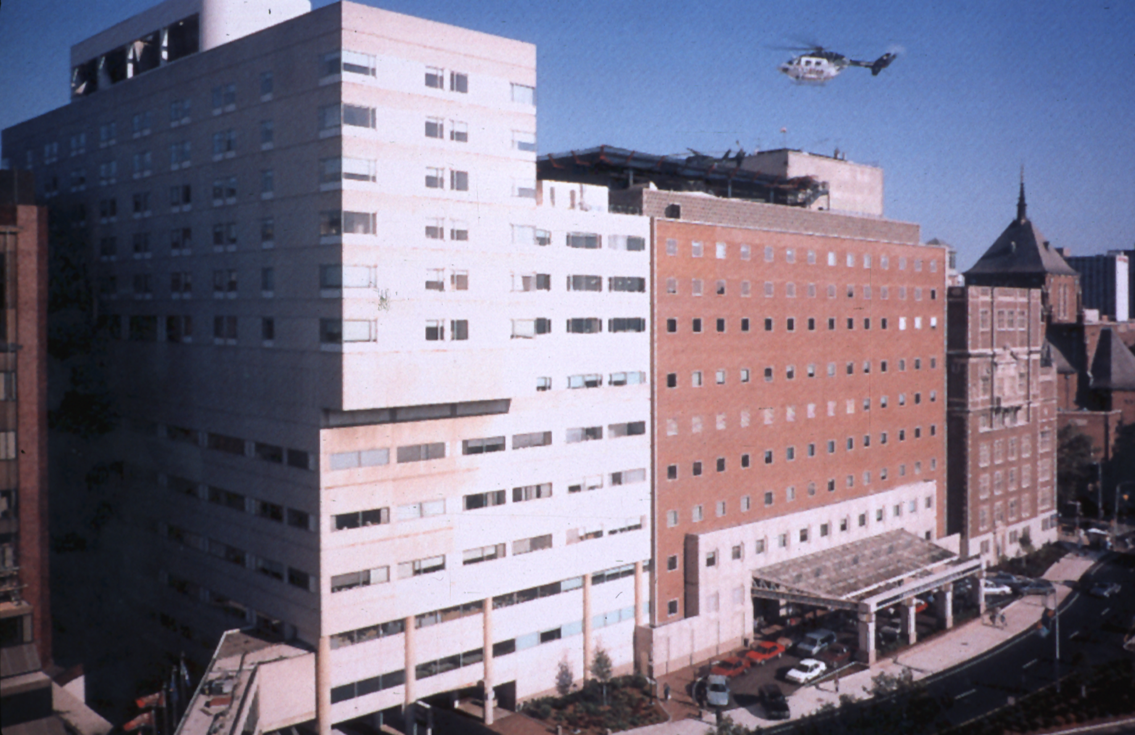
Helicopter YES
SICK PEOPLE IN HERE
Helicopter NO
Lil’ Brats

Slide 80


